Slide 1

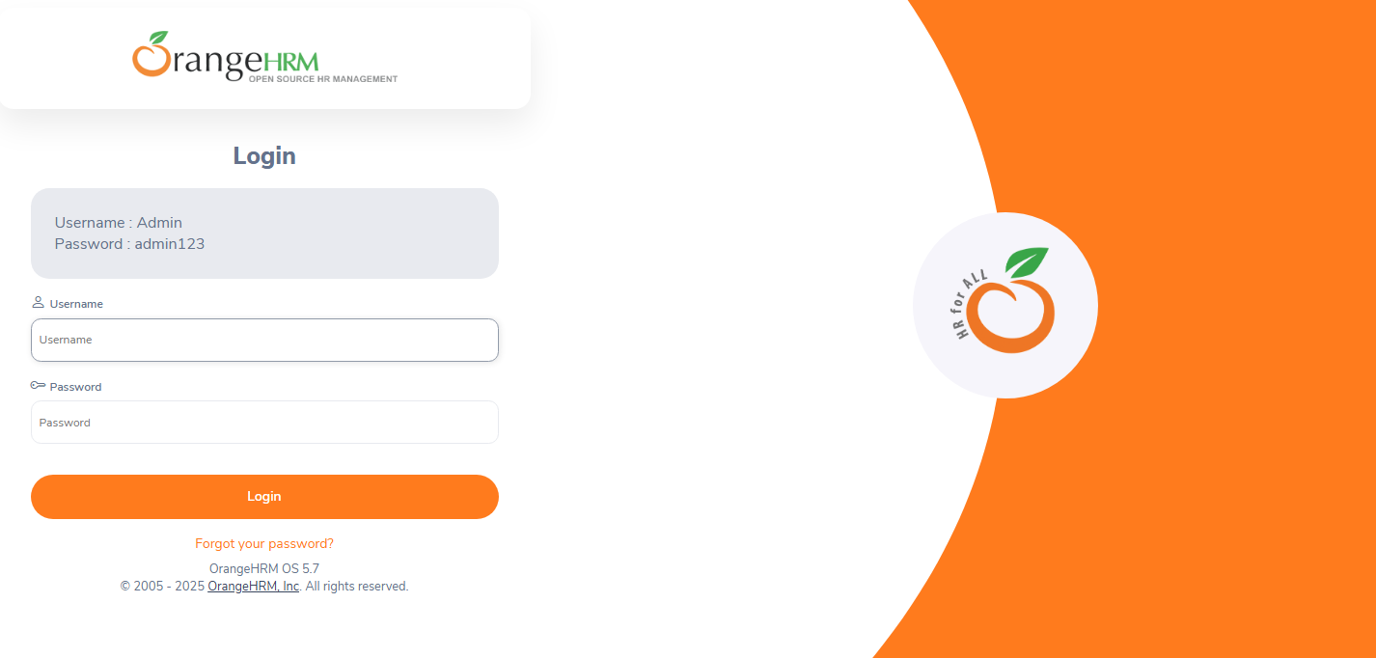
OrangeHRM Functional Testing Project
This presentation outlines our team's functional testing project for OrangeHRM.
We tested the Admin and ESS modules, ensuring they meet business requirements.
This involved STLC phases, test planning, RTM, test case design, execution, bug reporting, and a test summary report.
Our team of three effectively managed the project using Trello.
Group Members :
NE
by Nisreen Elaian
Yazan Al_Omari
YA
Dina Abuqare

Slide 2
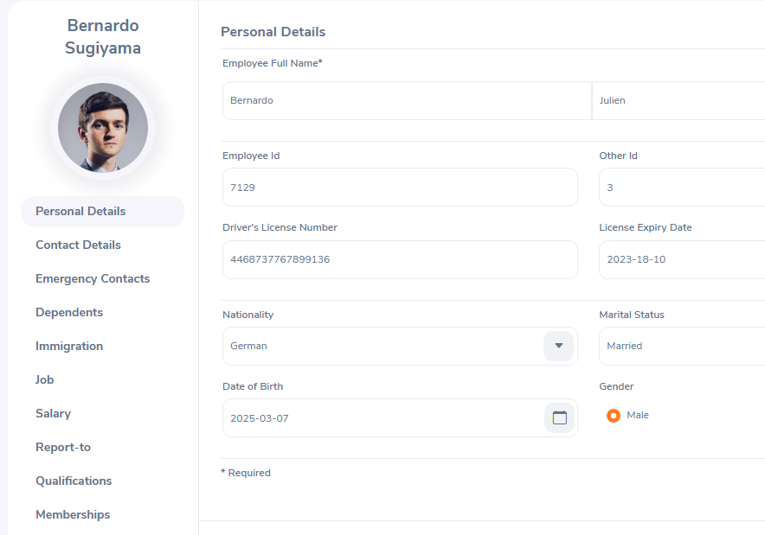
Project Overview: OrangeHRM
OrangeHRM is an open-source HR management system . Our project focused on functional testing for the Admin and ESS modules. The goal was to ensure these modules met business requirements. We excluded performance and security testing.
ESS Module
The ESS Module focused on testing the My Info (ESS View) module, including personal details, contact details, job details, Qualifications, Report to, Membership, Dependents, Immigration, and emergency contacts.
Admin Module
The Admin Module focused on testing functional aspects of the Admin module, including user management, job Details , organization settings, and Qualifications.

Slide 3


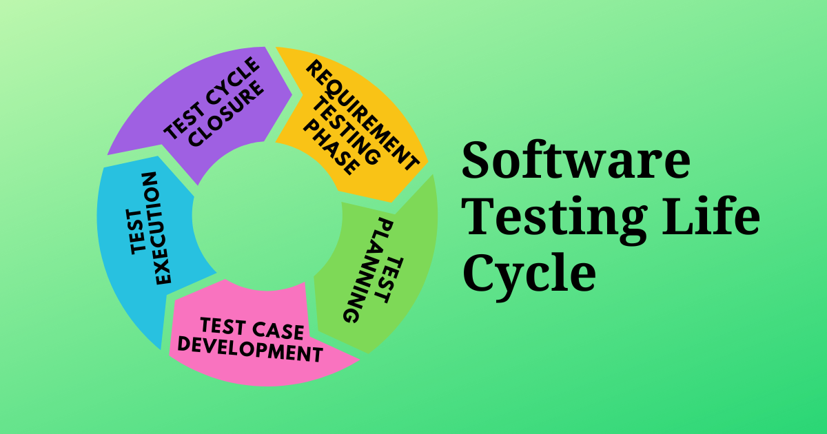




STLC Phases
Requirement Analysis
Understood the functional requirements extracted from SRS
Test Planning
Created objectives, scope, resources, and timelines.
Test Case Design
Designed test cases for various scenarios.
Test Execution
Executed test cases and logged defects.
Defect Reporting
Reported bugs using Excel
Test Closure
Prepared a summary report and shared findings.

Slide 4
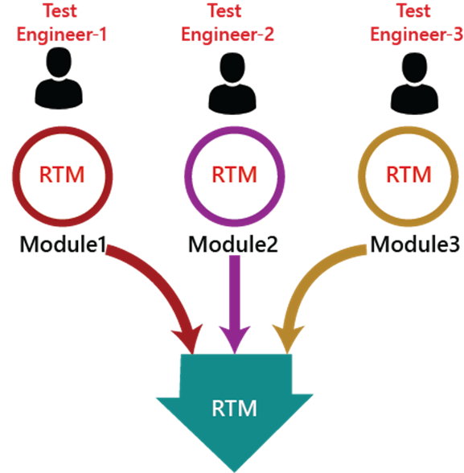
Test Planning and RTM
The test plan ensured functionalities worked as expected in the Admin and ESS modules. We used manual functional testing. The team included three testers, using Trello for task management. The RTM ensured all requirements were covered by test cases. This helped maintain complete test coverage.
Test Plan
RTM
Objectives: Ensure functionality.
Purpose: Cover all requirements.
Scope: Admin and ESS modules.
Requirements ID, Test Case ID.
Approach: Manual testing.
Status tracking.

Slide 5
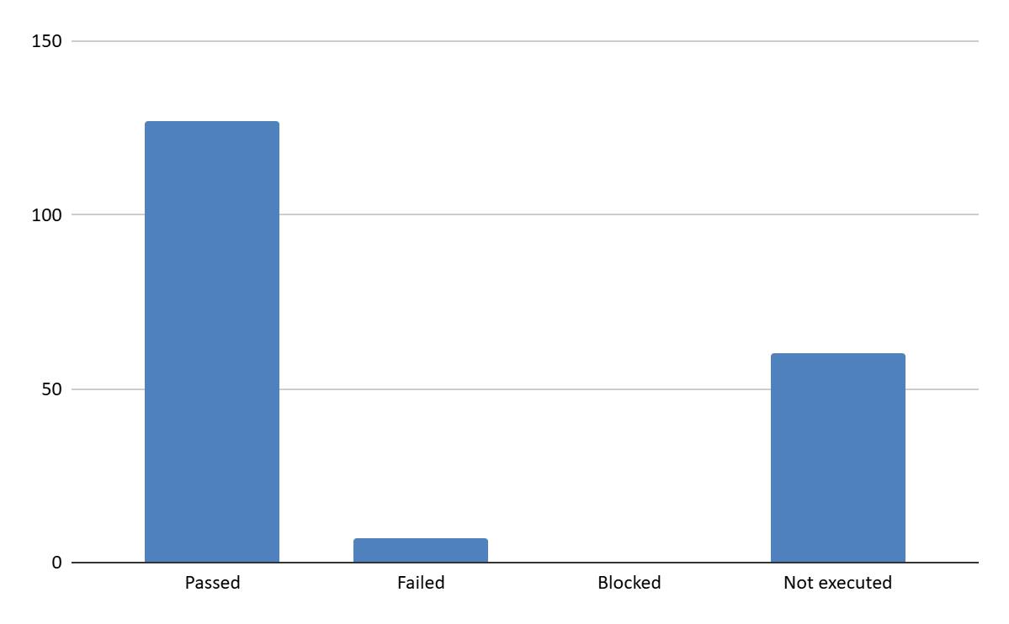
Test Case Design and Execution
We designed positive and negative test cases. For example, we tested adding a new user in the Admin module. During execution, test cases were run, results were logged, and defects were reported.
1
Positive
Valid Inputs
2
Negative
Invalid Inputs

Slide 6
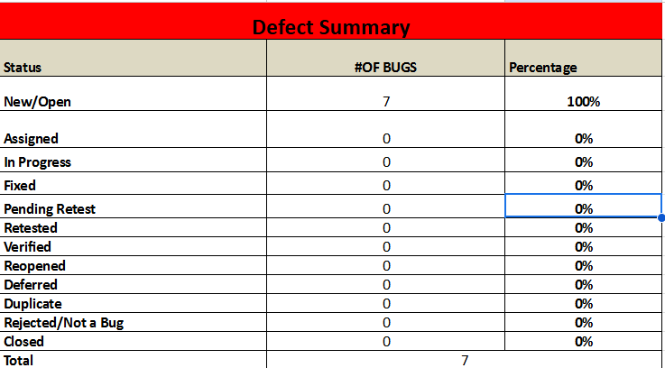
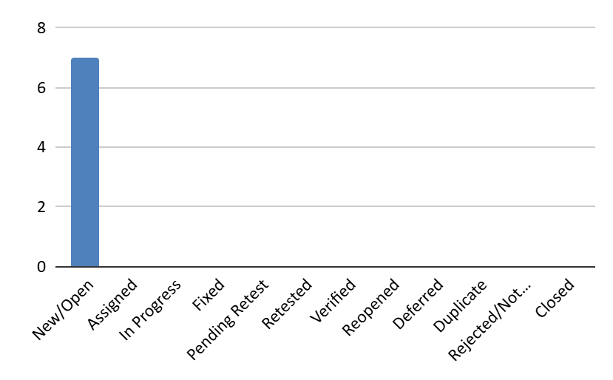
Bug Reporting and Defect Management
Our defect life cycle included identification, reporting, assignment, fixing, retesting, and closure. We used Trello to track defects. A critical bug in the Admin module prevented user creation, highlighting the impact of thorough defect management. Severity and priority were carefully assigned.

Slide 7
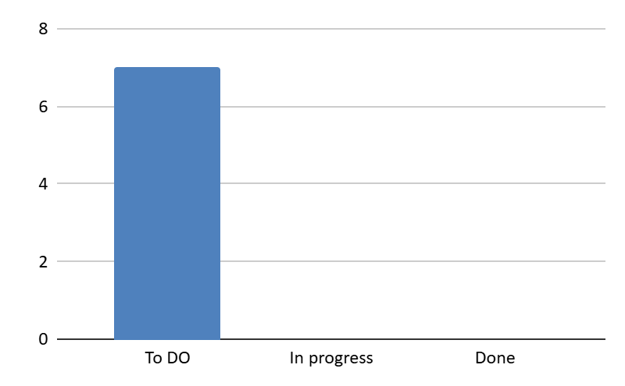
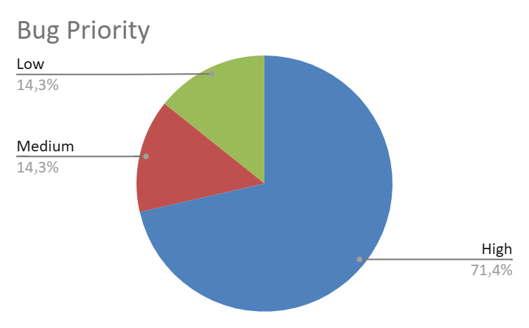
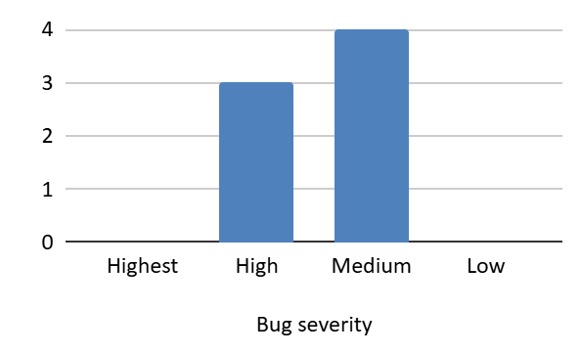
Defect Distribution Report
A Defect Distribution Report summarizes defects based on various factors such as severity, priority, module, testing phase, or root cause.
It helps in understanding the concentration of defects, improving software quality and optimizing testing efforts.

Slide 8
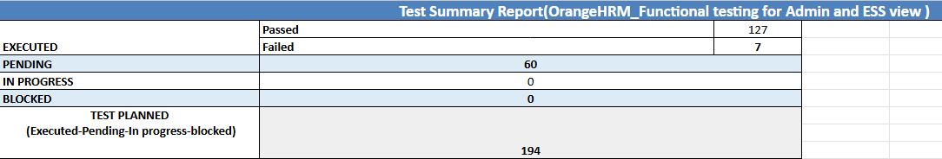
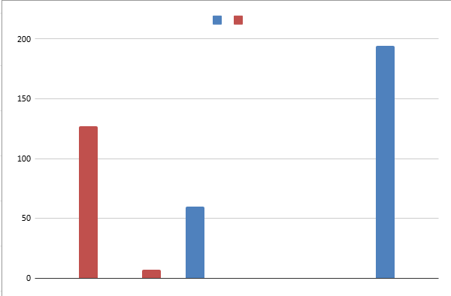
Test Summary Report
The Test Execution Summary Showed Cases :
127 Passed
7 Failed
60 Pending
We logged 7 defects with the following severities :
5 high
1 Medium
1 Low

Slide 9
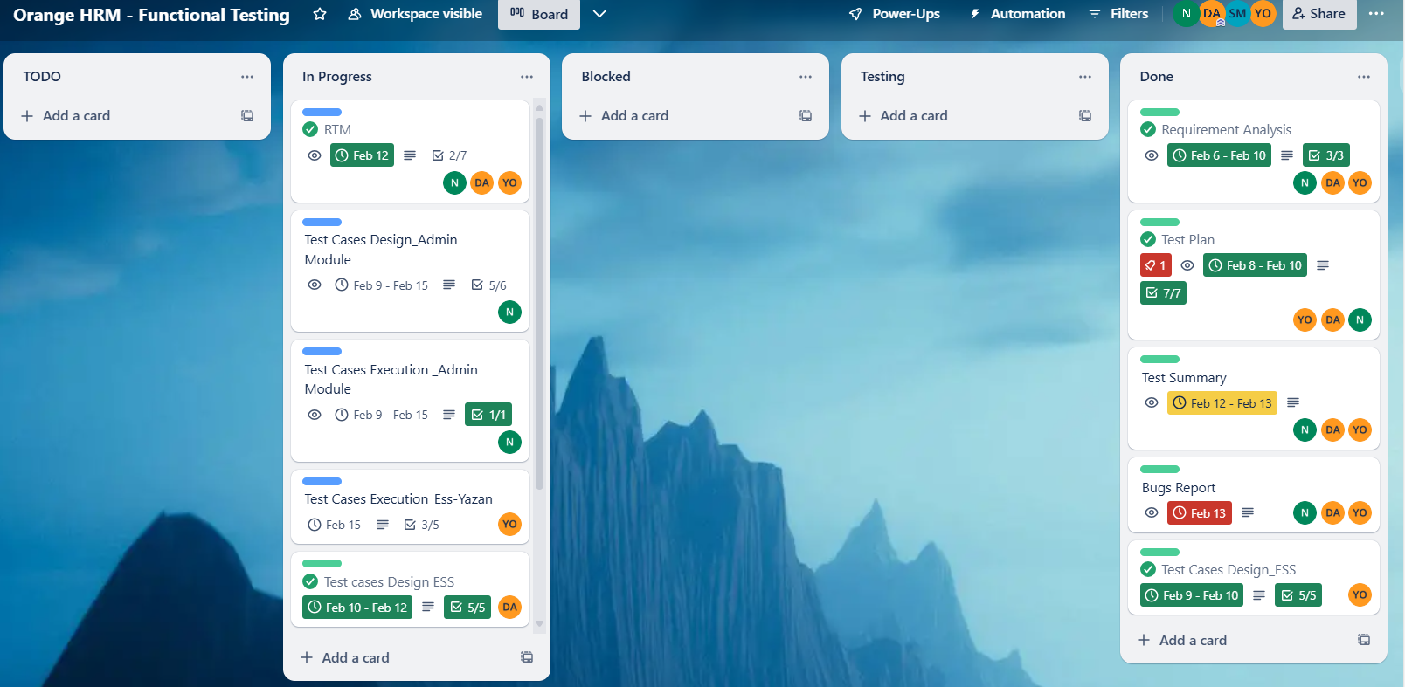




Team Collaboration and Tools
Our collaboration involved daily stand-ups and weekly meetings. Trello helped allocate tasks and track progress. We used Excel/Google Sheets for RTM and test case documentation. Clear communication and regular updates improved efficiency. These practices supported successful project completion.
Communication
Task Allocation
Documentation
Daily stand-ups
Trello for progress
Excel/Google Sheets

Slide 10

Challenges and Solutions
One of the main challenges we faced was a lack of experience, which we overcame by conducting frequent reviews with our instructors and doing thorough research.
Another challenge was managing our time effectively. To address this, we held regular team meetings and used Trello to stay organized and track our progress. These solutions helped us stay on track and successfully complete our project.
Challenge
Solution
Lack of Experience
Frequent reviews with Instructors and Good Research
Lack of Time
Constant Meetings with Team Members and Time Management using “Trello”.

Slide 11

Conclusion and Future Work
Our functional testing for OrangeHRM Admin and ESS modules successfully validated core features using positive testing and partial negative testing. Moving forward, we’ll expand test coverage to include boundary testing and more rigorous negative scenarios. We also plan to enhance documentation, and incorporate additional testing types like performance/security testing. Thank you to our team and stakeholders for making this project a success!
1
Enhance and improve documents
2
Expansion
more testing types, testing cross more environment

